Slide 1
How long do you expect to live?
Saiyid K, Samuel C, Debra P

Slide 2
Motivation
With the vast variety of resources, utilities, and factors around the world associated with our health as a human race, we were intrigued as to what kind of factors held correlations to longer life expectancies around the globe.
To understand the difference in life expectancy throughout the world, we decided we would find its association to key factors such as the prevalence of physicians and pharmacists, basic handwashing, drinking water services, and basic sanitation services. Using data that spans several decades from the past century, we revealed some obvious and not so obvious correlations to the length of human life!

Slide 3
Key Questions
01
How does access to water correlate with life expectancy?
02
Do hand washing habits correlate with life expectancy?
03
How does access to basic sanitation services correlate with overall life expectancy?
04
Does the number of Pharmacist in a country’s population correlate with the overall life expectancy?
05
Does the number of Medical Doctors in a country’s population correlate with the overall life expectancy?
06
How do various infrastructural factors correlate with each other (Medical Doctors per 10,000 vs Population using at least basic sanitization services (%), etc.)

Slide 4
Data Cleanup & Exploration
Let’s take a look at the jupyter notebook!
Finding Data Sets
Merging the Data
Cleaning the Data
Found data sets pertaining to quality of life from kaggle.com (view references for more info)
Joined all of our data sets and cleaned column headers based upon location (country) and period (year)
We ran into some unexpected issues regarding formatting and grouping
Not every data set was structured the same
Grouping on country is messy, needed to group in a more broad manner to see more general trends

Slide 5
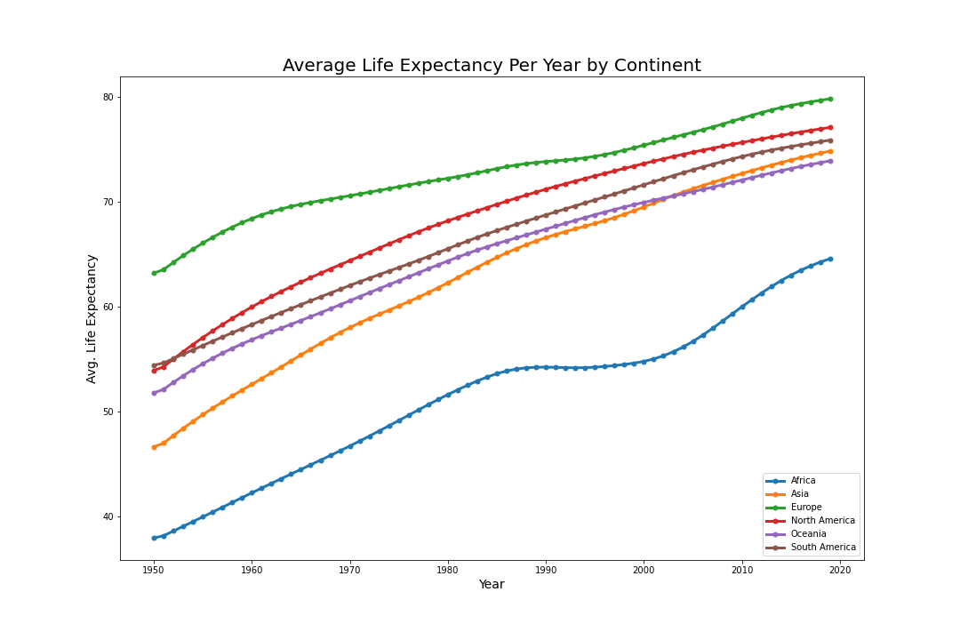
Benchmark
Pattern(s)
All included Continents have a positive trend throughout the elapsed time
Lines begin to plateau as we reach the end of the graph
Analysis
All countries have had success in increasing the average life expectancy since the 1950’s
Rankings for Most Growth
1. Africa and Asia
2. North America
3. Oceania and South America
4. Europe

Slide 6
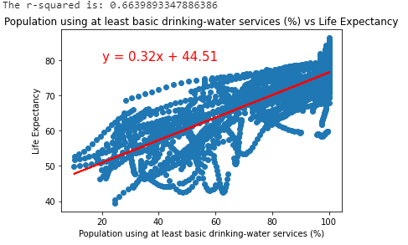
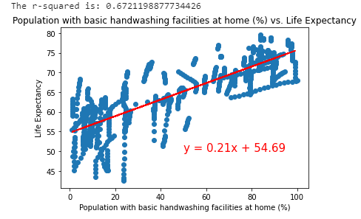
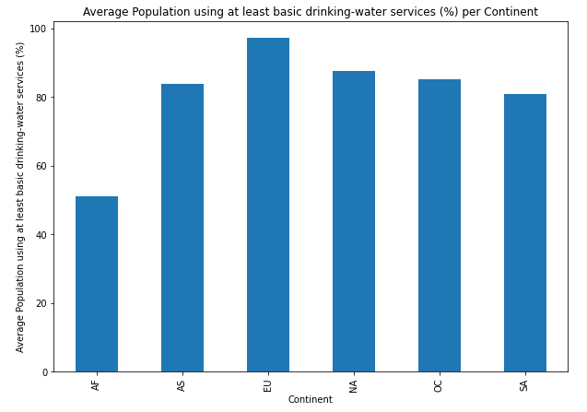
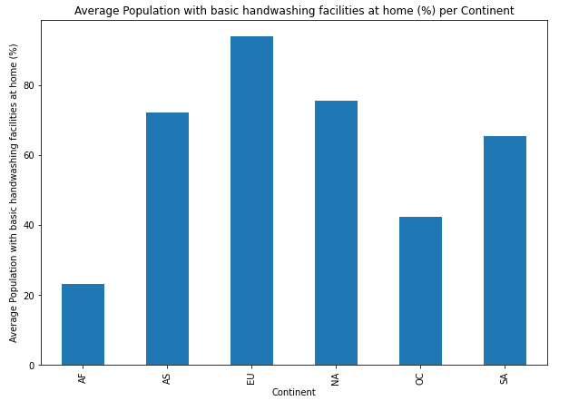
Data Analysis (p.1)
Moderately strong correlation b/w Avg Life Expectancy and % of Pop using at least basic drinking-water services and with basic hand washing facilities at home (r=0.66 and r=0.67, respectively)

Slide 7
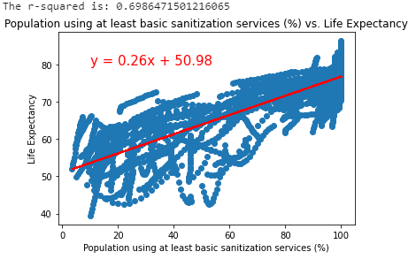
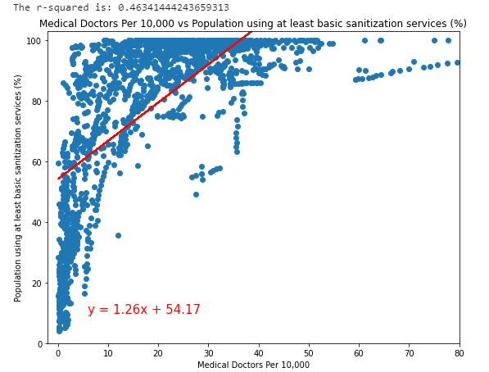
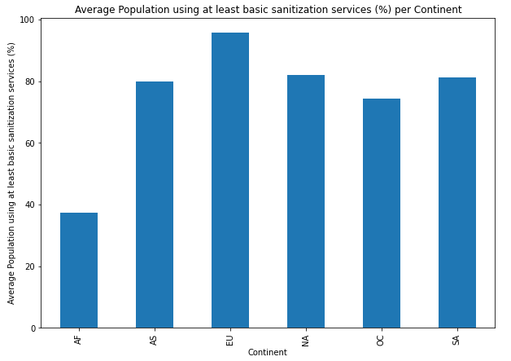
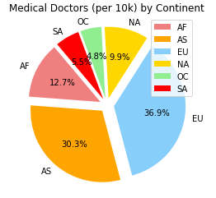
Data Analysis (p.2)
Again, there exists a moderately strong correlation b/w Avg Life Expectancy and % of Pop using at least basic sanitization services and Avg Number of Medical Doctors (per 10,000) (r=0.699 and r=0.46, respectively)

Slide 8
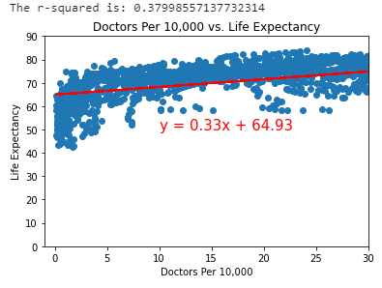
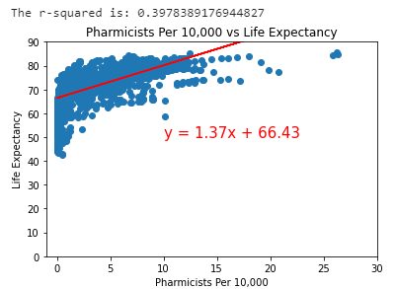
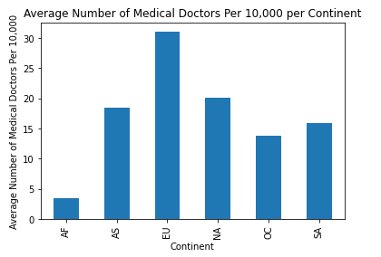
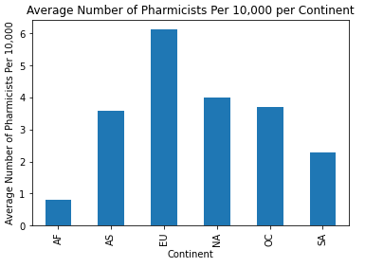
Data Analysis (p.3)
Surprisingly, not as strong of a correlation b/w Avg Life Expectancy and Avg Number of Medical Doctors and Pharmacists per 10,000 ( r = 0.38 and r = 0.398, respectively)

Slide 9

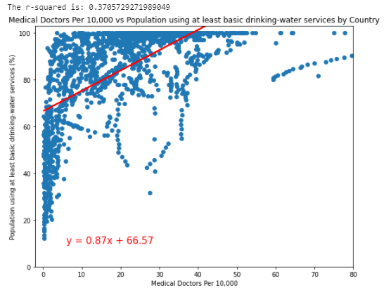
Data Analysis (p.4)
There exists some moderate correlation between the percentage of a country’s population using basic water and sanitation services and the number of medical doctors in a country’s population (r= 0.46 and r=0.37, respectively)

Slide 10
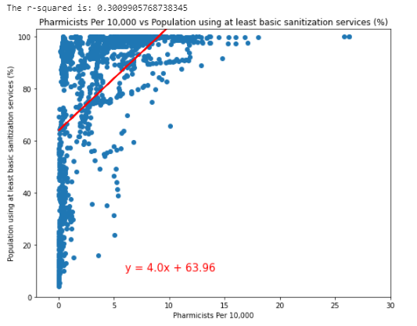
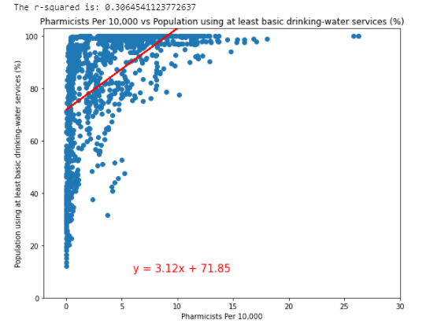
Data Analysis (p.5)
Similarly, there exists some moderate correlation between the percentage of a country’s population using basic water and sanitation services and the number of pharmacists in a country’s population (r=0.301 and r=0.306, respectively), though these correlations are not as strong when compared to medical doctors

Slide 11
Findings (p.1)
How does access to water correlate with life expectancy?
How do hand washing habits correlate with life expectancy?
These correlate highly. Between our data plots of Avg Life Expectancy and Avg % of Pop using at least basic drinking-water services and with basic hand washing facilities at home, we have respective r-values of 0.66 and 0.67.
This should be obvious as cleanliness (to avoid sickness) and clean, drinkable water are vital in living a long and healthy life.
How does access to basic sanitation services correlate with overall life expectancy?
Again, similar to our previous two questions, life expectancy and access to basic sanitation services have a high correlation (r=0.698).
This was to be expected as access to these services indicates that there is at least some more developed public infrastructure and therefore a better quality of life (in theory)

Slide 12
Findings (p.2)
How does the number of Pharmacist in a country’s population correlate with the overall life expectancy? How does the number of Medical Doctors in a country’s population correlate with the overall life expectancy?
Our results here were a little more surprising. Compared to our levels of correlation between infrastructure related variables and life expectancy, the number of medical doctors and pharmacists in the population have a lower correlation to life expectancy (r=0.380 and r=0.398, respectively)
Though these r-values aren’t necessarily weak, they suggest that these variables have a lesser impact on a country’s life expectancy than those discussed earlier
Why might this be the case?

Slide 13
Findings (p.3)
Do various infrastructural factors correlate with each other ? (Medical Doctors per 10,000 vs Population using at least basic sanitization services (%), etc.)
Although the presence of doctors or pharmacists in a pop doesn’t correlate highly with life expectancy, there does exist a correlation between infrastructure related variables and the presence of these individuals in a country’s population
This might suggest that when a country has more money to invest in public infrastructure, like water and sanitation services, more specialized healthcare workers arise in the population as the country is able to support them
This could be, in part, due to increased investment in education in more developed countries which would therein increase opportunities for those who pursue education in healthcare
More research would have to be done to support this connection, however

Slide 14
Post Mortem
Difficulties
Merging DataFrames with different formatting(Life Expectancy)
Turning Countries into Continents
Inferences about Data Analysis
Dealing with NaN for correlation graphs
Additional Question
Why doesn’t increasing the number of doctors have a strong correlation with life expectancy?
How do the other infrastructural variables relate to the others?
How does war affect life expectancy over the years?

Slide 15
References
https://www.kaggle.com/utkarshxy/who-worldhealth-statistics-2020-complete
https://www.kaggle.com/sansuthi/life-expectancy
https://www.kaggle.com/utkarshxy/who-worldhealth-statistics-2020-complete?select=basicDrinkingWaterServices.csv
https://www.kaggle.com/utkarshxy/who-worldhealth-statistics-2020-complete?select=basicHandWashing.csv
https://www.kaggle.com/utkarshxy/who-worldhealth-statistics-2020-complete?select=atLeastBasicSanitizationServices.csv
https://www.kaggle.com/utkarshxy/who-worldhealth-statistics-2020-complete?select=medicalDoctors.csv
https://www.kaggle.com/utkarshxy/who-worldhealth-statistics-2020-complete?select=pharmacists.csv

Slide 16
Time for discussion!
Any questions?

